Slide 1
Explanation on Mitotic Stage Classification
Chan-Min Hsu (許展銘)*, Shao-Ting Chiu (邱紹庭)**
Graduate Institute of Biomedical Electronics and Bioinformatics, National Taiwan University
Correspondences: *,**: {r07945010, r07945001}@ntu.edu.tw

Slide 2
Outline
Review of Mitotic Stage
Introduction
Method
Implementation
Result
Demo
Discussion
Conclusion
Reference

Slide 3
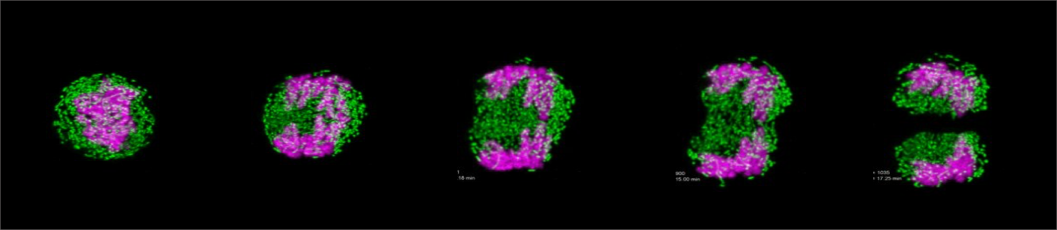
Review of Mitotic Stage
Stage
Anaphase
Concentration
Cytokinese
Stretching
Complete Mitosis

Slide 4
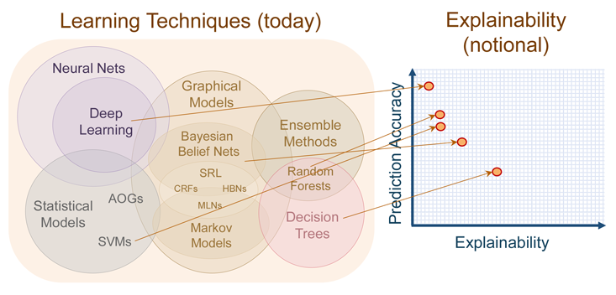
Introduction

Slide 5
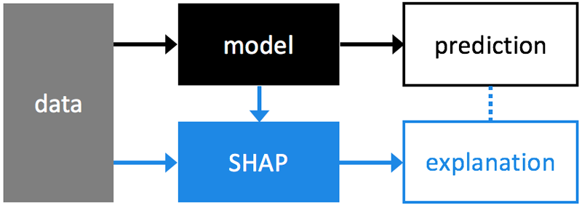
Method
SHAP Algorithm

Slide 6
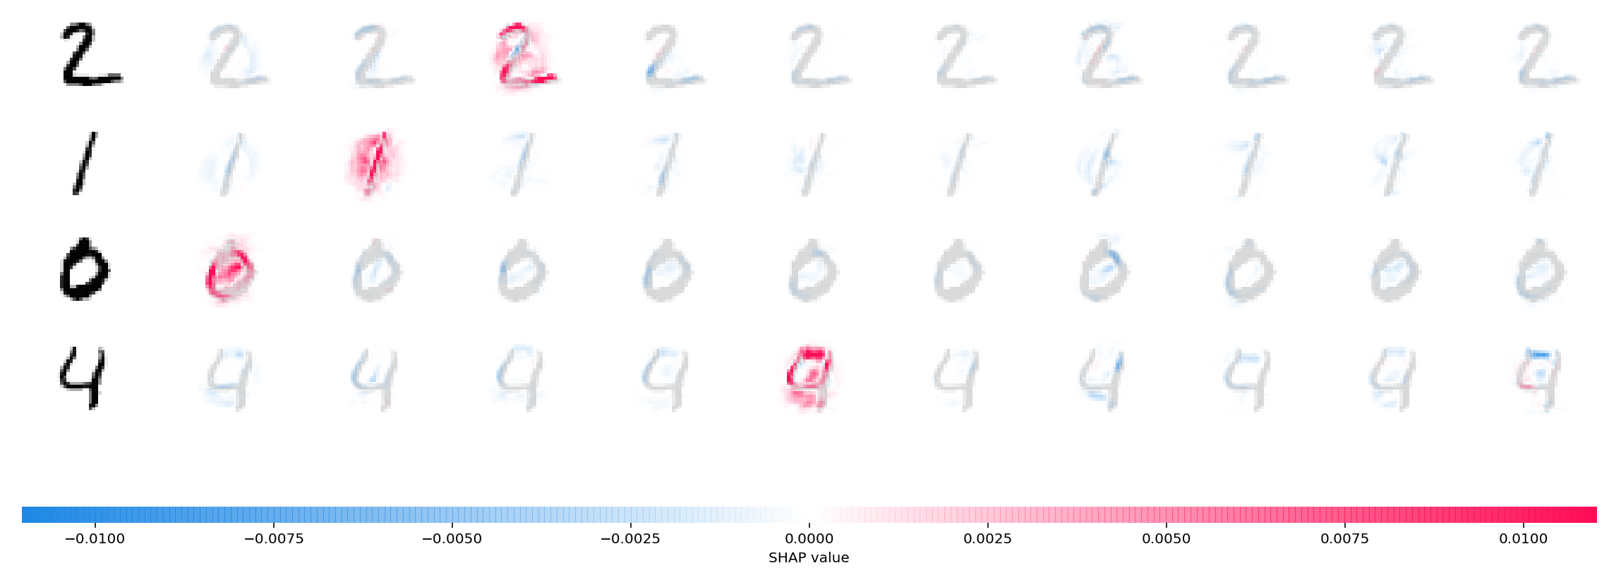
SHAP Example

Slide 7
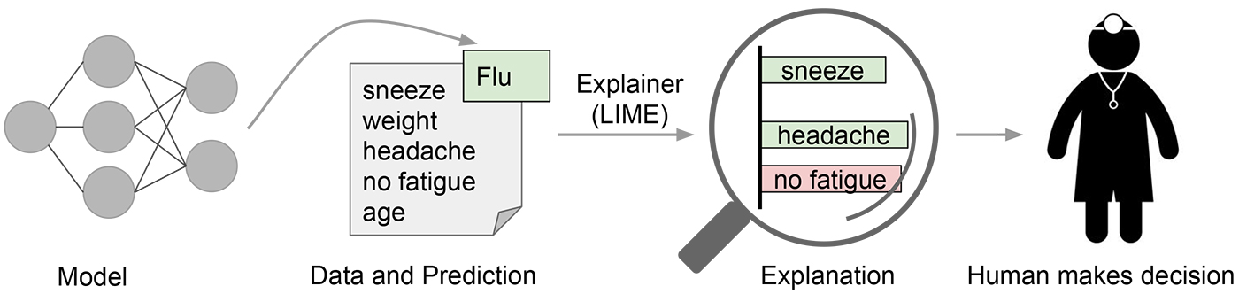
Method
LIME Algorithm

Slide 8
Implementation
Python Libraries
The SHAP algorithm is implemented by SHAP(https://github.com/slundberg/shap). The DeepExplainer function compute the result and plot function for image-showing.
The LIME algorithm is also implemented by LIME(https://github.com/marcotcr/lime). In the following porject, we will focus on this algorithm, including result and discussion.

Slide 9
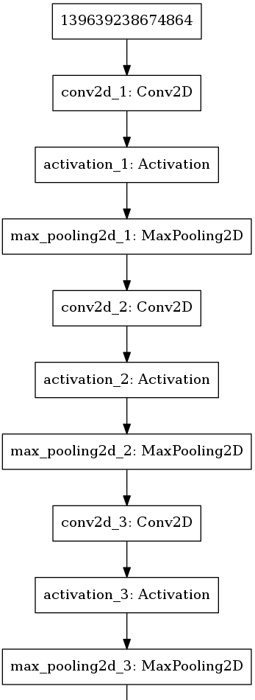
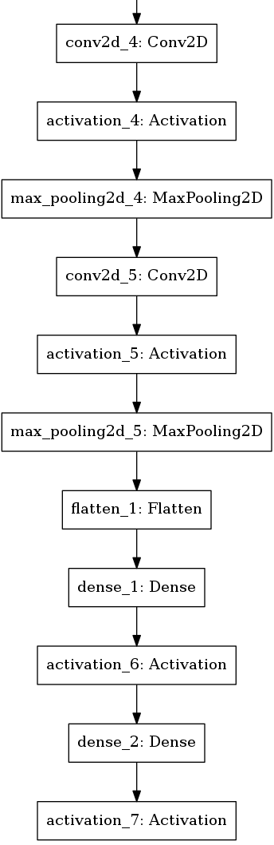
Model for Explanation
Review of CNN Model

Slide 10
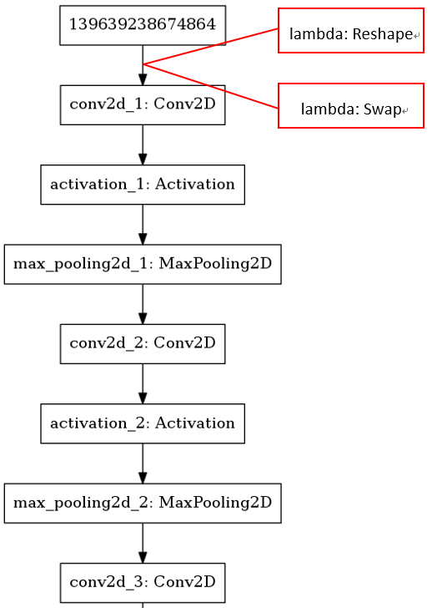
Model for Explanation
Modified Model

Slide 11
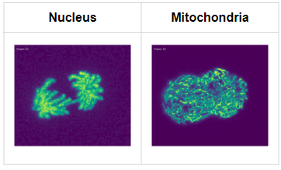
Result
Dataset
SHAP: Nucleus-labeled dataset trained by previous CNN.
LIME: Both mitochondria-labeled dataset and nucleus-labeled dataset trained by previous CNN separately.

Slide 12
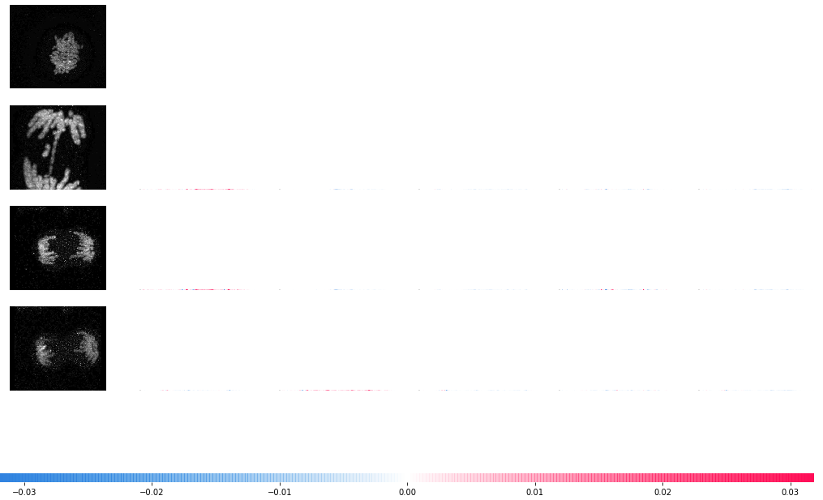
Result
SHAP

Slide 13
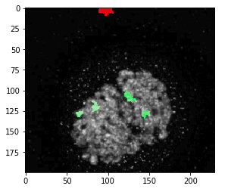
Result
LIME
Green mask shows the postive point on classification
Red mask shows the negative point on classification
Postive point means the model classify this local area correctly (same as growth truth), and vice versa

Slide 14
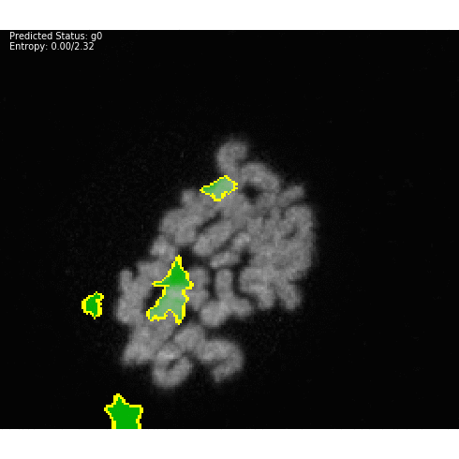
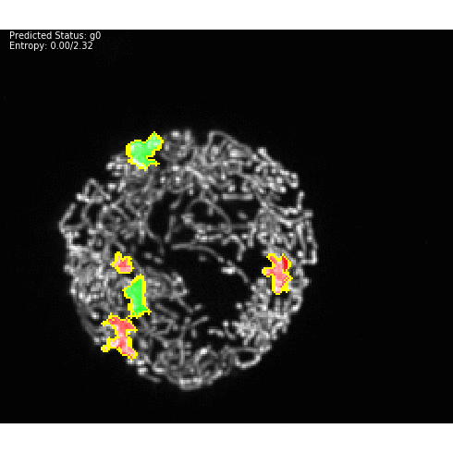
Demo

Slide 15
Discussion
Why the SHAP method choose such area for decision-maker?
There are some text annotations at the bottom of training data.
The total number of dataset is not big enough for interpreting.
The SHAP itself require the small size of frame as input (the MNIST example, 28 * 28 size), but our data are way too big comparing to that(the nucleus microscope image, 200 * 230 size), and this will cause the SHAP to emphasize on local area instead of global area.

Slide 16
Discussion
LIME's Performance
The error exists in the stage between G0 and anaphase mostly, but we can not explain the result through the positive and negative masks.
For the right prediction, we are still unable to determine which part of image is more important in mitotic stage classification.

Slide 17
Conclusion
In this project, we performed graphical explanation on the mitotic classification model.
In SHAP method, the results are not consistent because exhausted computation makes large sampling process unachievable.
Fortunately, LIME algorithm suggests that the models, which use either nucleus or mitochondria as feature, constantly use infra cell structure for mitotic stage structure.
Using mitochondrial morphology to predict mitotic stage providing potential application on drug toxicity test or inspiration on mitochondrial dynamics.

Slide 18
Reference
Ribeiro, M. T., Singh, S., & Guestrin, C. (2016, August). Why should i trust you?: Explaining the predictions of any classifier. In Proceedings of the 22nd ACM SIGKDD international conference on knowledge discovery and data mining (pp. 1135-1144). ACM.
Shrikumar, A., Greenside, P., & Kundaje, A. (2017, August). Learning important features through propagating activation differences. In Proceedings of the 34th International Conference on Machine Learning-Volume 70 (pp. 3145-3153). JMLR. org

